Slide 1
•
Insurance
WHY
Business Challenges
Use Case Description
KPIs Impacted
Claims teams spend significant time manually checking documents, leading to slow processing and backlogs.
Documents are often misclassified or submitted in the wrong format, requiring repeated customer follow‑ups.
Missing documents delay the claim lifecycle and create unnecessary customer touchpoints.
Lack of automation results in inconsistent decision-making and operational inefficiency.
Manual validation increases risk of human error and incomplete claim assessment.
This solution uses Agentic AI to automatically handle document gathering and document reviews for insurance claims. The system identifies all documents submitted by the customer, classifies them, and evaluates whether they meet the required criteria for the type of claim (e.g., GI, SIPP). If documents are missing, the AI triggers a chatbot agent to confirm whether files were misclassified or overlooked. If still missing, the system drafts a personalised customer email requesting the required documentation. When all documents are correctly submitted, the system updates the claims platform and proceeds to the next stage of the claims lifecycle — significantly reducing manual workload and improving processing efficiency.
Document review time reduction
Claim processing cycle time
Percentage of claims requiring rework
Customer communication turnaround time
Accuracy of document classification
Automation rate across claim intake steps
SmartDocs – Automated Claims Document Review & Data Gathering
Business Impact
Accelerates claims processing through end‑to‑end automation.
Reduces operational cost by removing repetitive manual document checks.
Improves customer satisfaction with proactive, personalised communication.
Minimises errors in classification and document verification.
Enables claims handlers to focus on complex, high‑value cases.
Produces consistent, auditable workflows compliant with regulatory standards.
Ingest all customer‑submitted documents from email, portal, or CRM.
AI classifies documents and identifies required vs submitted documents.
Agent verifies potential misclassified items through reasoning and chatbot dialogue.
If missing: AI drafts personalised customer email requesting specific documentation.
If complete: system auto‑updates claim status and pushes case forward for assessment.
Human intervention required only when AI identifies ambiguity or low‑confidence classifications.
HOW
WHO
Functional Solution
Stakeholders
Claims Handlers
Operations Managers
Customer Service Teams
Compliance & Risk Team
IT & Automation Team
End Customers
Technical Solution
Azure AI Foundry (Agentic Orchestration): Coordinates document reasoning, agent workflows, and decision steps.
Azure Document Intelligence: Extracts content, classifies documents, and identifies missing items.
Azure AI Search: Matches required documents with submitted ones using semantic search.

Slide 2
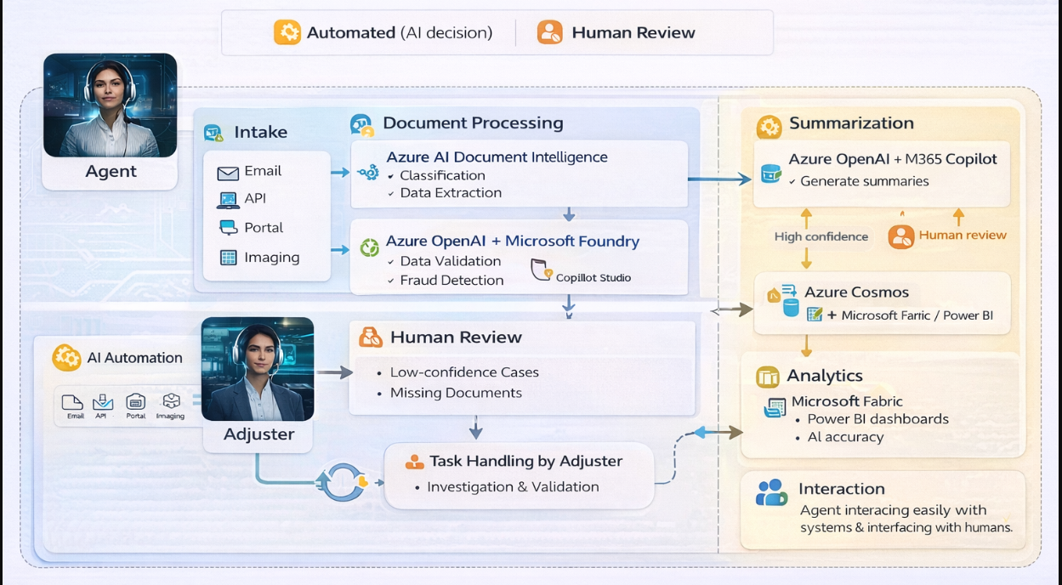
Functional Solution + AI-Human Chemistry

Slide 3
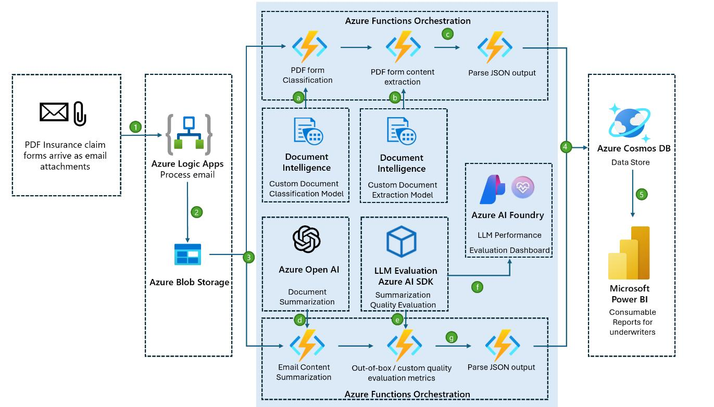
Technical Solution
technologies
GitHub Copilot
Microsoft Foundry
Microsoft Fabric
Azure Cosmos DB
Azure Blob Storage
Microsoft Power BI
Azure Document Intelligence
Azure Open AI
Copilot Studio
Azure AI

Slide 4
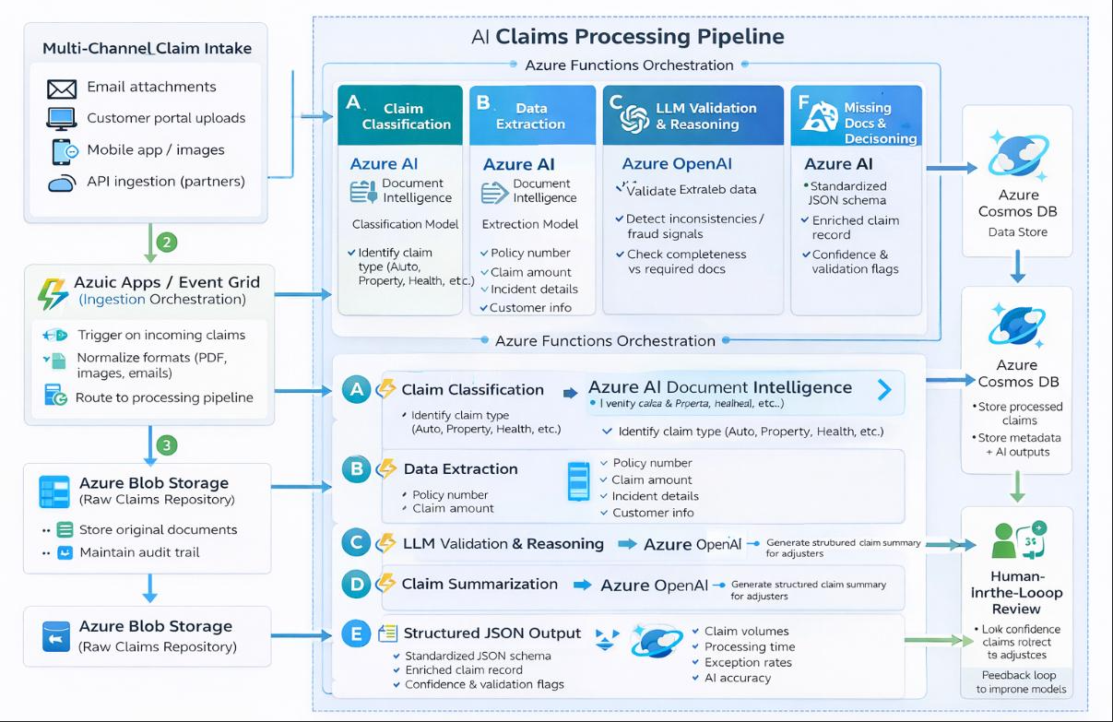
Technical Solution
technologies

